Slide 1

FATİH İLİĞ

Slide 2
Ders 7
Concurrent (Eş zamanlı) Statements

Slide 3
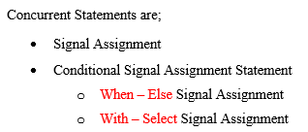
Concurrent Statements
Concurrent statements exist within architectures.
The order in which the concurrent statements are placed within the architecture is irrelevant because each concurrent statement is executed at the same time, effectively, as every other concurrent statement.

Slide 4
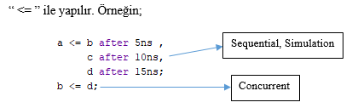
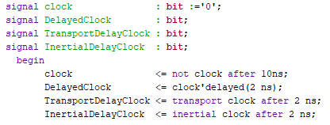
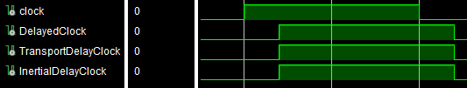
Basit sinyal ataması
Example

Slide 5
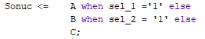
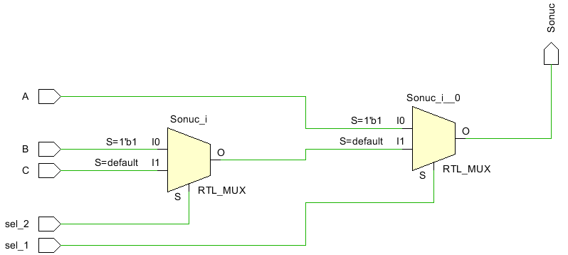
Koşullu sinyal ataması (Conditional Assignment)
Concurrent bir atama söz konusudur. Process yoktur. In that case make sure that most critical input listed first and least critical input listed last.
Example : In that case, A is most critical

Slide 6
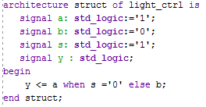
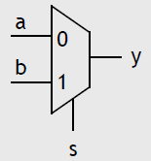
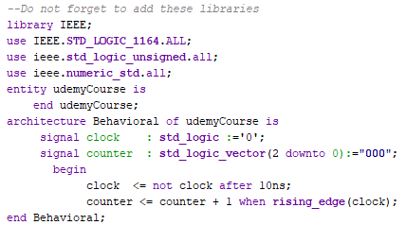
Example:
Example :

Slide 7
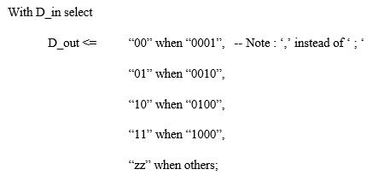
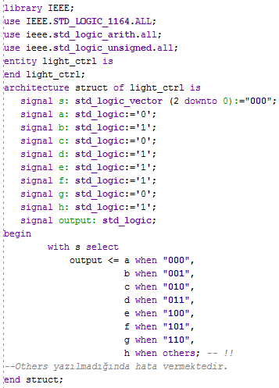
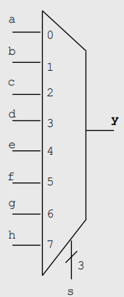
Seçimli atama (Select Assignment)
ÖRNEK: Selected Signal Assignment – Mux 8 to 1

Slide 8
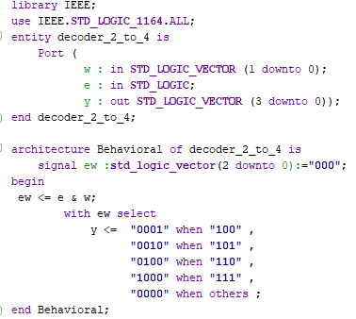
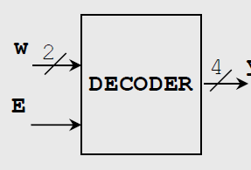
ÖRNEK: Decoder 2 to 4 with enable

Slide 9
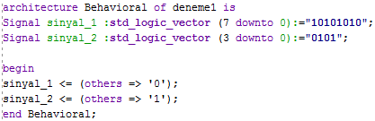
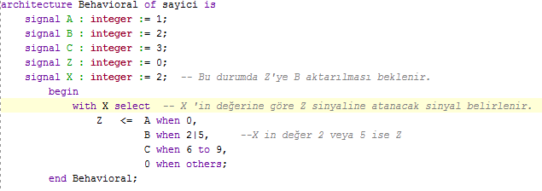
Others kullanarak sinyal atama
Bir sinyal değerinin belli bir kısmına aynı bitler yazılacaksa others kullanılarak bu işlem yapılabilmektedir.
ÖR :

